Slide 1

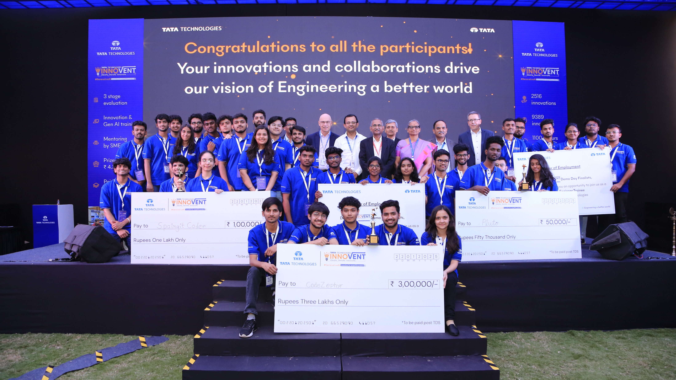

AI-Led CAN Bus Monitoring for Real-Time Vehicle Cybersecurity (Securing In-Vehicle Communication with AI) Nag Aditya Redboina K L University

Slide 2
Stage 2 Presentation content
The supporting presentation must cover dedicated slides on the below content:
Problem Statement
Objective and Approach
Solution Overview
Solution Architecture
Challenges Faced
Technical Implementation
Code Contributions i.e. custom algorithms, machine learning models, and integrations unique to your project.
Results and Achievements
Demonstration video
Link to access the source code
Future Enhancements that the team has planned for stage-3 Final demo day round
Project Plan for POC completion by stage-3 Final demo day round in Jan-25

Slide 3
Project Files Drive Link
https://drive.google.com/drive/folders/1B6GFFRcgSWO9qqG1XBIsJTN1gFjTVmCj?usp=sharing

Slide 4

Introduction
Team Name : Code on Chip
Mentor Name : Dr. AV Prabu sir
Teams members Name | Roles | Contribution
Nag Aditya Redboina | Hardware and Data analysis, ML model documentation | Hardware integration and worked on data analysis for model training and evaluation.
K Ranga Nitheesh Kumar Reddy | ML model and Preprocessing the dataset , hardware integration | Handled ML model development and preprocessing; worked on model training, data cleaning, and integration with CAN hardware.
Praneeth Gujjeti | Data Collection | Collected CAN datasets from online sources and supported data preparation for training and testing.

Slide 5
Problem statement
Problem Statement: Machine Learning Vigilance: Real-Time Anomaly Detection for CAN Bus Protection for Enhanced Automotive Cybersecurity
The automotive industry is rapidly evolving towards highly connected and increasingly autonomous vehicles. While this connectivity enables advanced features, enhanced user experiences, and Over-The-Air (OTA) updates, it simultaneously expands the attack surface for cybersecurity threats.
The Controller Area Network (CAN bus) remains the primary communication backbone within most vehicles, interconnecting Electronic Control Units (ECUs) responsible for critical functions ranging from engine control and braking systems (ABS, ESP) to infotainment and body controls.
Originally designed for reliability in a closed system, the CAN protocol lacks fundamental security features like message authentication, encryption, or source verification.
This inherent vulnerability makes it susceptible to various cyberattacks if an attacker gains access, either remotely (e.g., via compromised infotainment or telematics units) or physically (e.g., via the OBD-II port).
A successful attack on safety-critical systems via the CAN bus can have catastrophic consequences, directly endangering the driver, passengers, and other road users. Therefore, robust and timely detection of anomalous or malicious activity on the CAN bus is paramount for ensuring vehicle safety and security.

Slide 6

The Core Problem & Potential Impact: Unauthorized manipulation of CAN bus messages poses severe risks. Attackers can inject malicious messages to: Spoof legitimate ECU messages: Causing unintended actions like sudden acceleration/deceleration, disabling airbags, manipulating steering, or displaying false information to the driver. Flood the bus (Denial-of-Service - DoS): Overwhelming legitimate ECUs, preventing critical messages from being transmitted or processed, leading to system failure or unpredictable behavior. Fuzzing attacks: Injecting malformed or random data to discover vulnerabilities or crash ECUs.
Injection of Attack Message
Alert
Detecting
ECU
Monitoring CAN message and detecting Attacks
telematics units or External Connection (OBD-ll)
ECU
ECU

Slide 7
Objective and Approach
To develop a real-time anomaly detection framework using machine learning to protect the CAN bus in modern vehicles from cyber threats, attacks, and malfunctions. By providing vigilance against unauthorized or suspicious activities on the CAN network, the solution aims to enhance automotive cybersecurity and ensure reliability in connected, safety-critical systems.
Chosen Approach: Implement Light-GBM-based machine learning with a custom preprocessing pipeline for hex-to-numeric conversion, noise handling, and balanced sampling.
We selected Light-GBM over deep learning models (CNN, LSTM) because it provides:
Lower latency on Raspberry Pi.
Lightweight memory footprint compared to DL models.
Higher interpretability (feature importance).
Better handling of class imbalance in CAN datasets.
Hardware Integration: Deploy the model on Raspberry Pi for real-time, on-vehicle detection.
Comparison with Existing Solutions: Unlike heavy ML/DL models (MCFO-DANN, SVM, KNN) that require high computation or offline testing, our approach is lightweight, fast, and edge-deployable.
High-Level Phases: Data collection → preprocessing → model training → edge deployment → real-time detection → alerting.
Impact: Provides a scalable, interpretable, and cost-effective solution that bridges academic research and practical automotive cybersecurity deployment.

Slide 8
Approach
Data Collection
Data
Preprocessing
Training the ML model
Validation and Testing of ML model
Hardware integration
Monitoring

Slide 9
Solution Overview
End-to-End IDS Pipeline: Built a complete flow from CAN data collection → preprocessing → ML training → real-time deployment on embedded hardware.
Lightweight ML Model: Used Light-GBM for high accuracy (~89%) with low resource usage, enabling deployment on Raspberry Pi.
Real-Time Detection: Integrated with Raspberry pi to classify live CAN traffic as normal or anomalous in milliseconds.
Custom Preprocessing: Designed a unique hex-to-numeric + balanced sampling pipeline to handle noisy real- world CAN logs effectively.
Pipeline handles noise & missing CAN frames by:
Converting hex-to-numeric robustly.
Filtering inconsistent/malformed packets.
Using balanced sampling to reduce class bias.
Ensuring stable detection in real-time streams.
Explainability & Trust: Stored feature importance and signal mapping so detected anomalies can be traced to specific CAN signals.
Innovation & Impact: Delivers a low-cost, scalable, and interpretable in-vehicle IDS that bridges the gap between academic research and practical automotive cybersecurity.

Slide 10
Solution Overview
Data Collection & Analysis
Gathered CAN bus datasets from online sources.
Analyzed data distribution, attack types (DoS, Fuzzy, Spoofing), and feature patterns.
Machine Learning Modeling
Developed a Logistic Regression model for initial feature exploration and understanding the dataset.
Built a robust Light-GBM Classifier ml model , trained and tested on the collected dataset.
Preprocessing converts CAN hex/string → numeric; handles missing or extra features.
Hardware Deployment
Deployed the trained (.pkl) model on Raspberry Pi.
Key Features & Innovations
Real-time detection of multiple attacks (DoS, Fuzzy, Spoofing).
Lightweight & memory-efficient ML suitable for edge devices.
Adaptive & retrainable to detect new or unknown attacks.
Cost-effective solution using open-source hardware/software.
Interpretable outputs through feature importance, providing actionable insights for engineers.
Datasets used: Kaggle Car-Hacking Dataset & DTU CAN dataset. These include DoS, Fuzzy, Spoofing attacks. While representative of many real-world attacks, additional in-vehicle datasets are required for broader coverage. To address dataset drift and evolving attack patterns, our model supports retraining with new CAN traffic logs post-deployment

Slide 11
Input Signal
Technical Implementation
Technologies Used: Light-GBM for ML, Python (pandas, scikit-learn), Raspberry Pi and joblib for model deployment.
Custom Data Pipeline: Built a preprocessing framework (hex-to-numeric conversion, noise filtering, balanced sampling) to handle real-world CAN logs efficiently.
Model Training & Deployment: Achieved ~89% accuracy using Light-GBM, then optimized and deployed the model on Raspberry Pi for real-time inference.
Hardware Integration: Connected Raspberry Pi to monitor live CAN traffic and detect anomalies on-vehicle.
Scalability: Architecture supports adding new attack types and retraining without major redesign, making it adaptable for future threats.
Flexibility & Cost Impact: Demonstrates a lightweight, low-cost IDS solution that bridges lab research and practical, in-vehicle cybersecurity deployment.
ML Model Detection
Checking
Alert
Attack signal
Original signal
CAN

Slide 12
Novelty
Conducted prior art review of ML-based CAN Bus IDS (SVM, KNN, Deep Learning, MCFO-DANN) to identify gaps in real-time, resource-efficient deployment.
Developed a custom preprocessing pipeline (hex-to-numeric conversion, noise handling, balanced sampling) tailored for real-world CAN logs.
Trained a Lightweight Gradient Boosting (Light-GBM) model, achieving accuracy (≈89%)
Successfully integrated with Raspberry Pi hardware, proving feasibility for deployment in vehicles.
Added explainability features (feature importance & CAN signal mapping) to improve trust and compliance with automotive safety standards.
Provides a scalable, cost-effective IDS solution that bridges the gap between academic research and practical automotive cybersecurity deployment.

Slide 13
Challenges Faced
1. Handling Large Dataset
Challenge: Dataset had millions of rows, causing memory and performance issues.
Strategy & Solution: Implemented chunk-based reading and stratified sampling to process manageable batches.
Lesson Learned: Always build scalable and memory-efficient data pipelines when working with real-world datasets.
2. Class Imbalance
Challenge: Attack classes like Fuzzy, Gear, and RPM were under-represented compared to Normal.
Strategy & Solution: Used balanced sampling while training and applied class weights in LightGBM.
Lesson Learned: Addressing imbalance early ensures the model is not biased toward majority classes.
3. Feature Mismatch Across Versions
Challenge: Training and test datasets had different feature sets, leading to KeyErrors and misalignment.
Strategy & Solution: Standardized preprocessing, saved feature list (JSON), and reindexed test data to match training features.
Lesson Learned: Ensure consistent feature engineering pipelines across training, validation, and testing.
4. Baseline Model Limitations
Challenge: Initial baseline model (SGDClassifier) had low accuracy and poor generalization.
Strategy & Solution: Iterated to LightGBM, which provided better handling of categorical/numeric mix and class imbalance.
Lesson Learned: Start simple for benchmarking, but upgrade to advanced models for production-level performance.

Slide 14
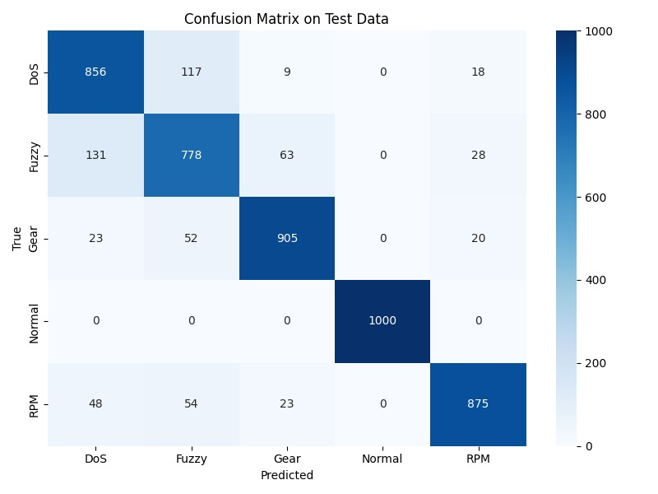
Results and Achievements
ML Model Testing Result

Slide 15
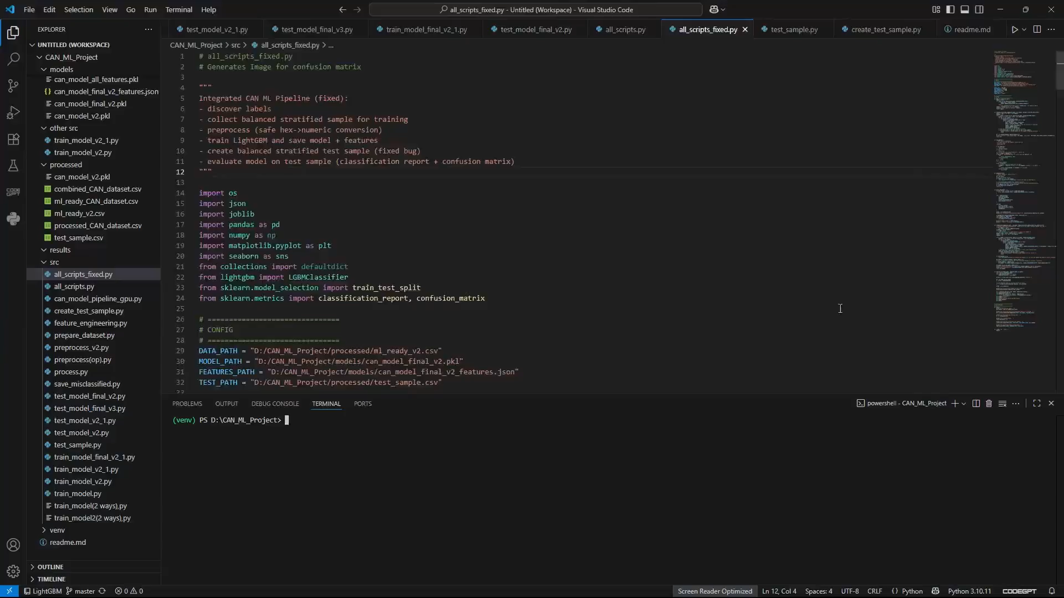
Results and Achievements
ML Model Testing Result

Slide 16
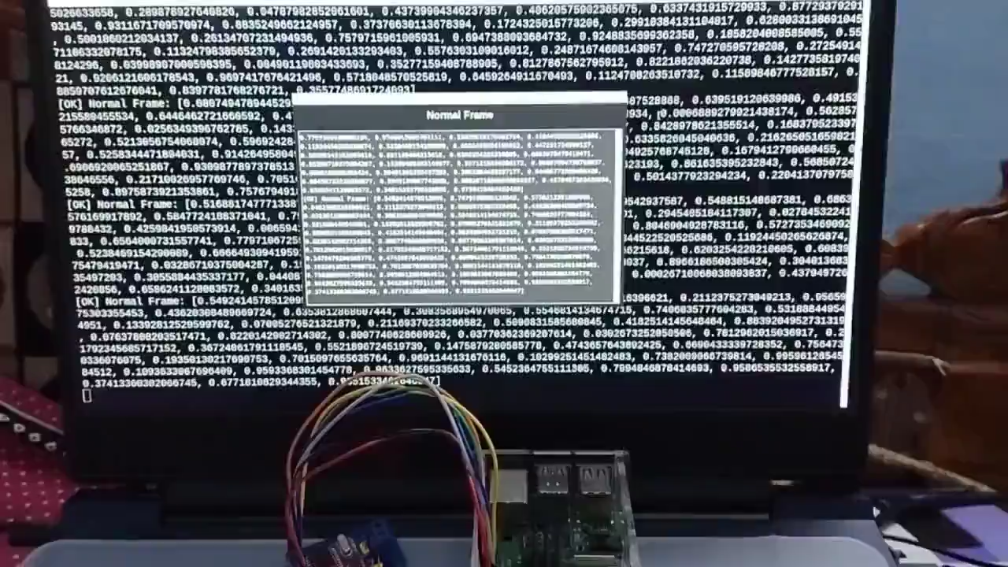
Demonstration of POC/prototype with videos, photos

Slide 17
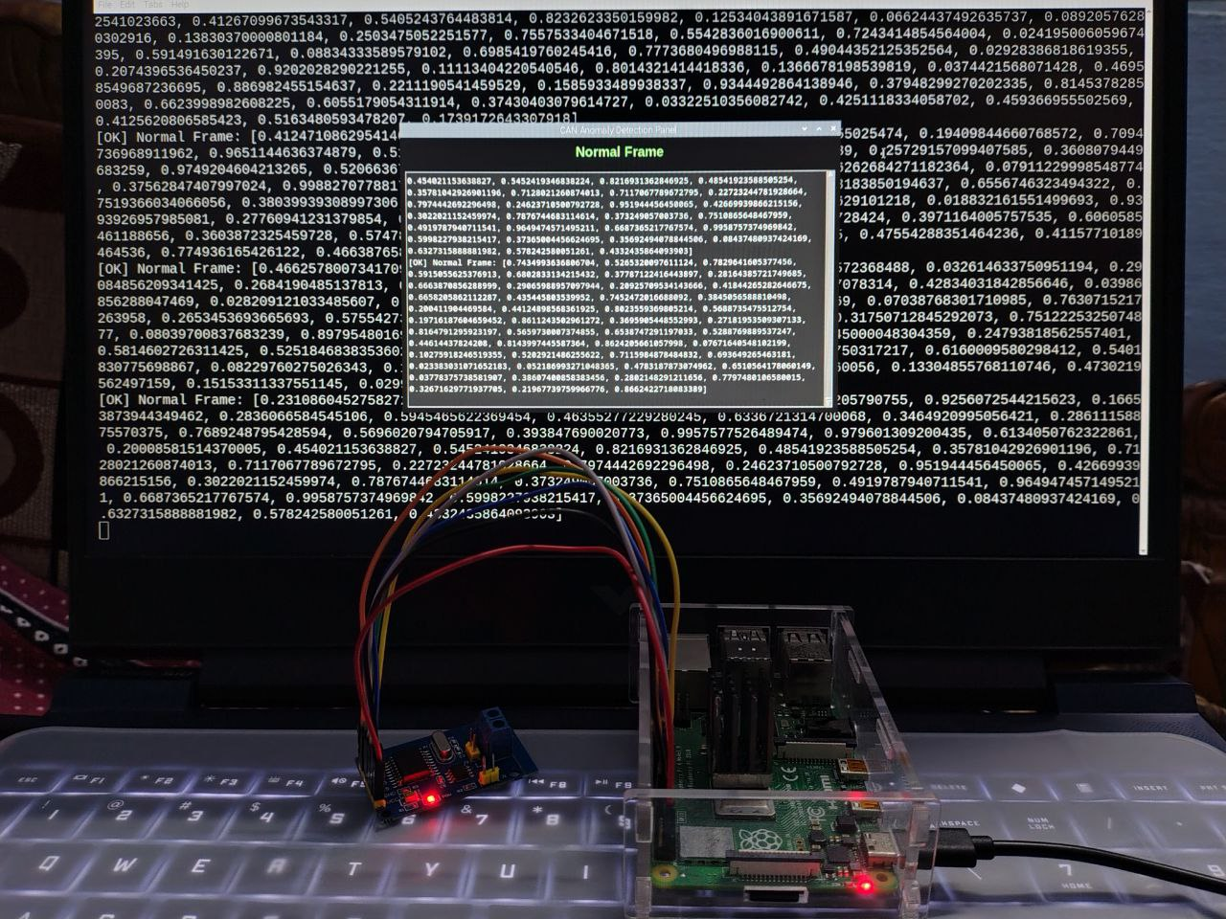
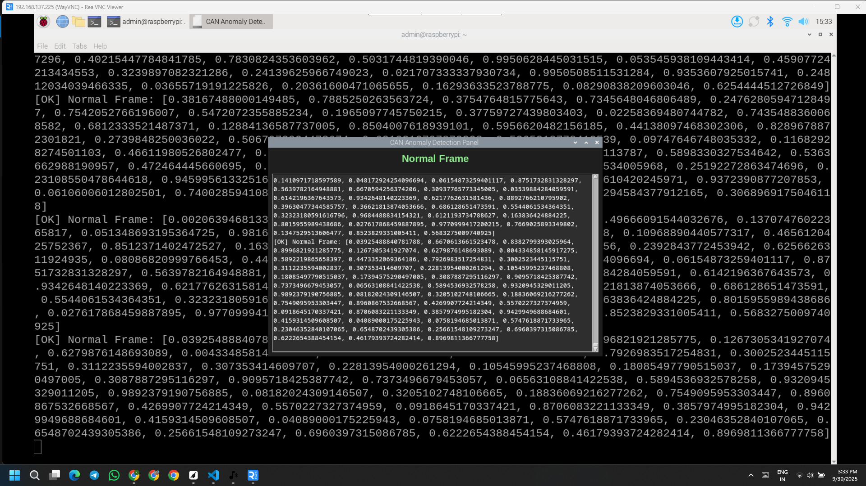
Demonstration of POC/prototype with videos, photos

Slide 18
Project plan for completion of prototype
Milestone | Tasks | Deliverable | Timeline (Weeks)
M1: Data Preparation | Collect CAN datasets, preprocess (hex → numeric), balanced sampling | Cleaned, balanced dataset | Week 1–2
M2: ML Model Development | Train LightGBM, validate, save model + feature mapping | Trained model (~89% accuracy) | Week 3–4
M3: Hardware Integration | Setup Raspberry Pi, MCP2515 CAN modules, deploy model | Raspberry Pi + CAN bus ready | Week 5
M4: Testing & Validation | Test with real CAN traffic | Verified and stable prototype | Week 6
M5: Documentation & Demo | Prepare demo video, final presentation | Hackathon-ready prototype & report | Week 7

Slide 19
Future Enhancements
Zero-day Attacks: Extend anomaly-based detection + continuous retraining to capture unknown threats.
Dashboard: Interactive dashboard for engineers to monitor live CAN traffic & alerts.
Dataset Drift: Regular retraining to handle evolving CAN traffic & attack patterns.
Compliance: Plan to align with ISO/SAE 21434 & UNECE WP.29 cybersecurity standards. Comprehensive Attack Coverage: Expand detection to all known CAN attack types, including spoofing, replay, fuzzing, and emerging threats, ensuring robust vehicle security.
Edge-Optimized ML Deployment: Apply model pruning, quantization, or lightweight ensembles to achieve faster inference and lower power usage on embedded devices.
Real-Time Interactive Dashboard: Develop a visual, user-friendly interface that shows live CAN traffic, detected anomalies, and trend analytics for engineers and operators.
Over-the-Air (OTA) Updates: Implement remote model updates and retraining, keeping vehicles continuously protected against new and evolving attacks.
Explainable & Actionable Insights: Enhance interpretability by mapping anomalies to specific CAN signals, supporting quick troubleshooting, safety audits, and regulatory compliance.

Slide 20
References
https://www.kaggle.com/datasets/pranavjha24/car-hacking-dataset
https://data.dtu.dk/articles/dataset/can-train-and-test/24805533?file=43632393
https://arxiv.org/pdf/2406.16369

Slide 21
Thank you

